Slide 1
W4153 – Cloud Computing Lecture 1: Introduction, Concepts
© Donald F. Ferguson, 2024

Slide 2

W4153 – Cloud Computing Lecture 1: Introduction, Concepts
We will start in a few minutes.
If you ask me about the waitlist, I will become very grumpy.
© Donald F. Ferguson, 2024

Slide 3
Design Patterns
Introduction
3 | W4153-24F-L1-Introduction-Concepts © Donald F. Ferguson, 2024

Slide 4
Design Patterns
“In software engineering, a software design pattern is a general, reusable solution to a commonly occurring problem within a given context in software design. It is not a finished design that can be transformed directly into source or machine code. Rather, it is a description or template for how to solve a problem that can be used in many different situations. Design patterns are formalized best practices that the programmer can use to solve common problems when designing an application or system.” (https://en.wikipedia.org/wiki/Software_design_pattern)
We will cover design patterns in several aspects:
SW patterns for building code “in microservices.” How do you write the code?
Architecture patterns for microservices and composition into complex solutions.
Cloud architecture patterns: how do you solve problems with cloud technology.
Data modeling and data access patters.
… …

Slide 5
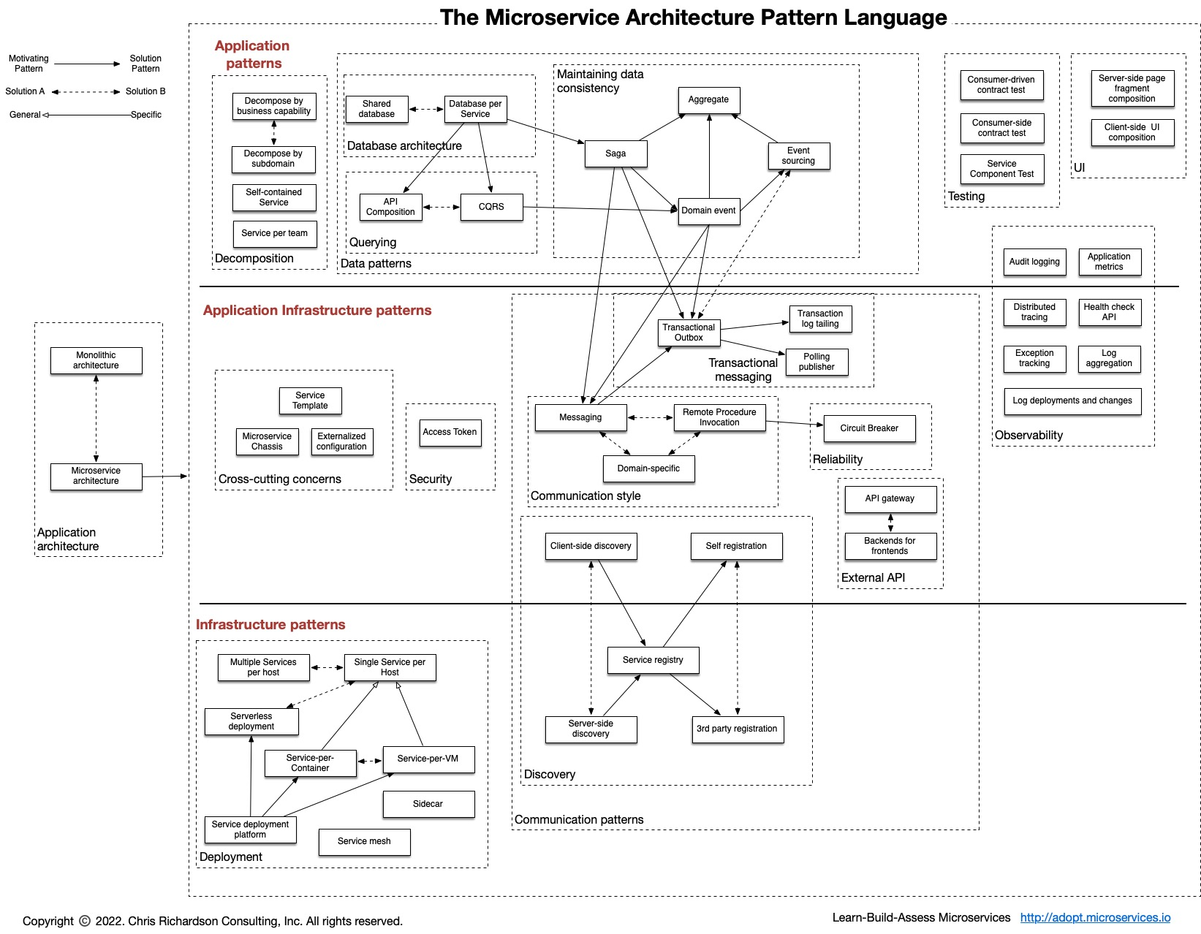
Microservice Pattern Language (One Perspective)
If you are trying to solve a problem or implement something,
You are probably not the first person to do so.
Probably a lot of other people have tried, failed and then learned.
Ask Google or ChatGPT what others do.
A knowledge of basic design patterns is useful to guide architecture/implementation decisions.
We will cover when encountering tasks and challenges.
https://microservices.io/patterns/index.html

Slide 6
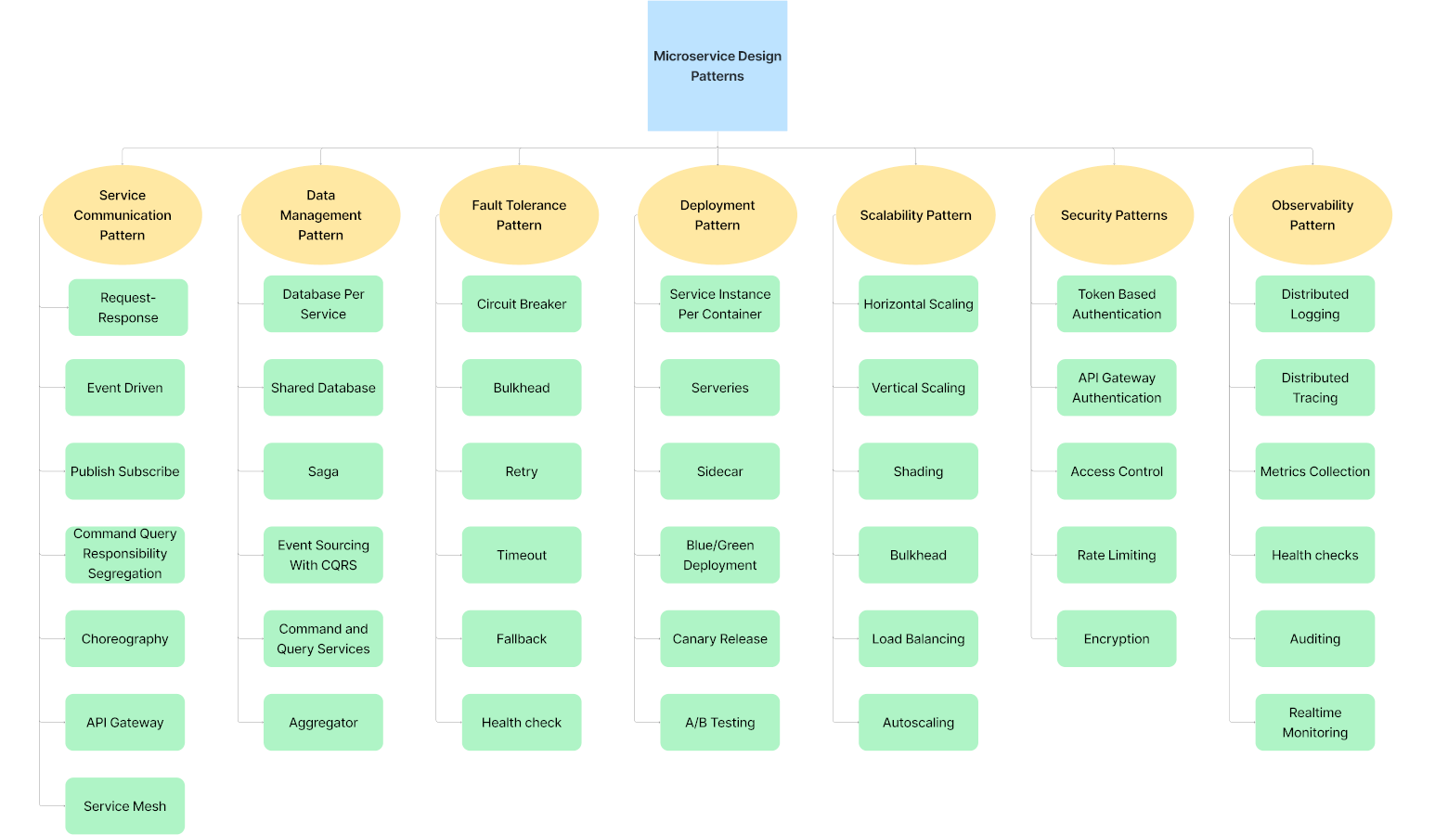
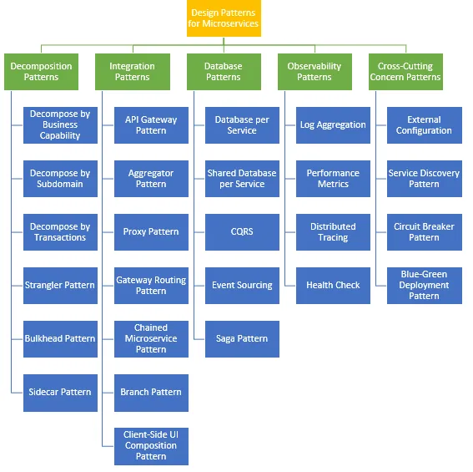
There are a Lot of Design Patterns
https://blog.beehyv.com/design-patterns-in-microservices-enhancing-scalability-flexibility-and-maintainability-197e499a575b
https://medium.com/@madhukaudantha/microservice-architecture-and-design-patterns-for-microservices-e0e5013fd58a

Slide 7

W4153 Introduction to Databases:
Faculty do not manage waitlists for some courses, including W4153.
The academic admin staff in the CS Department manages the waitlist, priorities and enrollment.
You should contact advising email:
ug-advising, ms-advising, or phd-advising @cs.columbia.edu
7 | W4153-24F-L1-Introduction-Concepts © Donald F. Ferguson, 2024

Slide 8
Contents
8 | W4153-24F-L1-Introduction-Concepts © Donald F. Ferguson, 2024

Slide 9
Contents
Course Overview
About your instructor.
Course objectives, logistics, structure, grading, … …
Core Concepts
Cloud computing concepts.
Full stack web application.
An aside on modeling.
Microservices.
Application development concepts.
Sprint 0 – Get Ready for the Remainder of the Course
Form teams.
Individual end-to-end project to validate that you are ready for the coursework.
Discussion, Questions, “Lab”

Slide 10
Course Overview
10 | W4153-24F-L1-Introduction-Concepts © Donald F. Ferguson, 2024

Slide 11
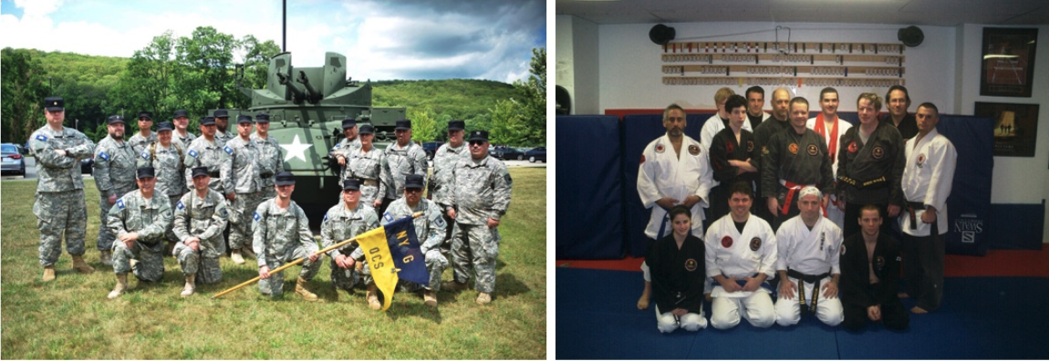
About your Instructor
38 years in computer science industry:
IBM Fellow.
Microsoft Technical Fellow.
Chief Technology Officer, CA technologies.
Dell Senior Technical Fellow.
CTO, Co-Founder, Seeka.tv.
Ansys (current):
Ansys Fellow, Chief SW Architect;
VP/GM, Cloud, AI, Solutions and Developer Enablement BU (CASEBU)
Academic experience:
BA, MS, Ph.D., Computer Science, Columbia University.
Approx. 18 semesters as an Adjunct Professor.
Professor of Professional Practice in CS (2018)
Courses:
E1006: Intro. to Computing
W4111: Intro. to Databases
E6998, E6156: Advanced Topics in SW Engineering (Cloud Computing)
Approx. 65 technical publications; Approx. 12 patents.
Personal:
Two children:
College Sophomore.
2019 Barnard Graduate.
Hobbies:
Krav Maga, Black Belt in Kenpo Karate.
Former 1LT, New York Guard.
Bicycling.
Astronomy.
Languages:
Proficient in Spanish.
Learning Arabic.
I have taught some version of this class 10 times.

Slide 12
Logistics and Grading
Logistics
Lectures: Friday’s 1:10 to 3:40 PM
I can present and cover material much more quickly than you can “use and implement.” ➔
1:10 to 2:50-ish will be lecture and presenting/teaching material.
2:50-ish to 3:40 will be “in the lecture room ‘labs’” where you can work on projects, ask questions, discuss details.
I will periodically devote a lecture slot to extended offices hours, project team meetings, etc.
Office Hours: Friday’s 8:30 AM to 10:00 AM and 4:00 PM to 5:00 PM.
A total of 100 points is available:
Your final team project earns up to 75 points.
Written individual homework assignments earn up to 25 points.
Earning an A+ requires the TAs and my seeing and recognizing individual extra effort that we reward with extra-credit. We will let you know when we assign extra-credit points.
“Extraordinary results come from doing ordinary things extraordinarily well.”
“The harder I work, the luckier I get.”

Slide 13
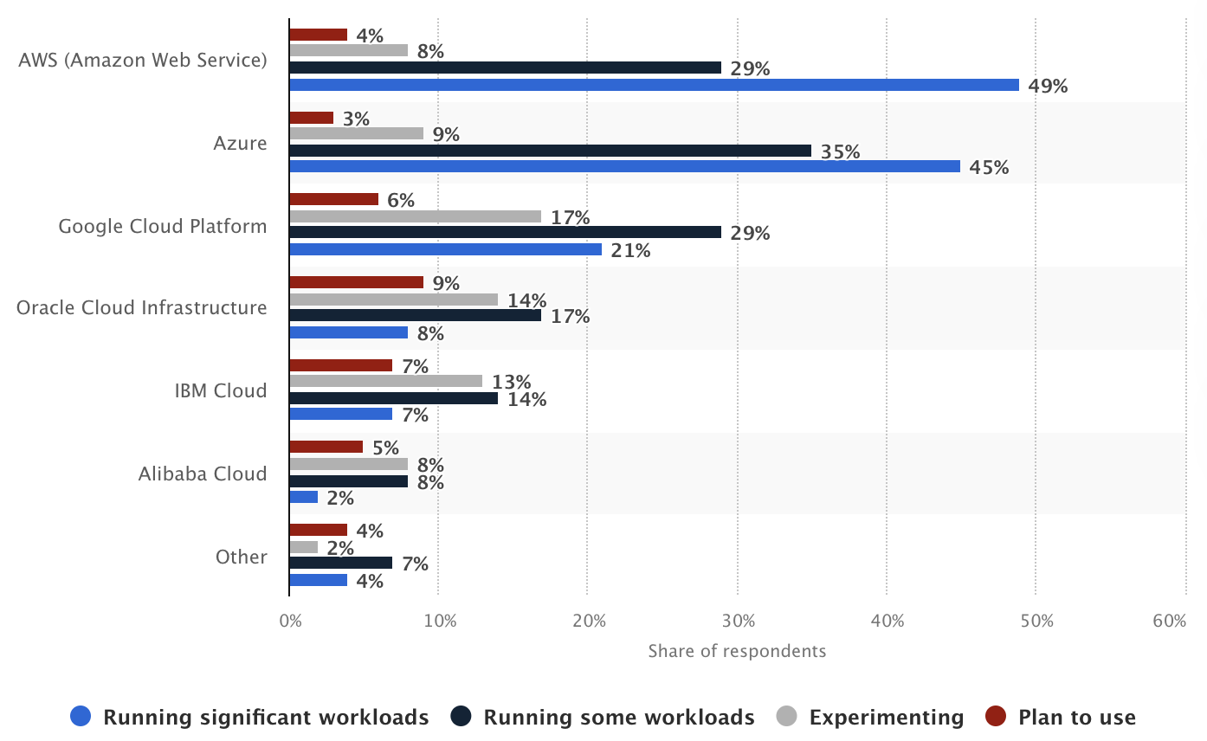
Environment and Systems
There are 3 primary cloud service providers:
Microsoft Azure
Google Cloud Platform
Amazon Web Services
The course will focus on concepts and use the clouds for implementations.
Managing costs:
All clouds have “free tiers” and/or “new user” credits. You must track and manage your costs.
We have credits for Google Cloud Platform.
I am working on credits and free usage for AWS and Azure.
I suggest that you also mirror/follow my usage of locally installed SW for development:
PyCharm, DataGrip, WebStorm including cloud usage plugins.
Docker
Others will follow during semester.

Slide 14
Objectives

Slide 15
Core Concepts (Initial, There are More)
15 | W4153-24F-L1-Introduction-Concepts © Donald F. Ferguson, 2024

Slide 16
Cloud Computing
(Initial – There are More)
Introduction
16 | W4153-24F-L1-Introduction-Concepts © Donald F. Ferguson, 2024

Slide 17
Definitions – As Good as Any of the 10⁶ Definitions
“Simply put, cloud computing is the delivery of computing services—including servers, storage, databases, networking, software, analytics, and intelligence—over the internet (“the cloud”) to offer faster innovation, flexible resources, and economies of scale. You typically pay only for cloud services you use, helping you lower your operating costs, run your infrastructure more efficiently, and scale as your business needs change.” (https://azure.microsoft.com/en-us/resources/cloud-computing-dictionary/what-is-cloud-computing)
“Cloud computing is a delivery model for providing on-demand information technology (IT) infrastructure and services over the Internet. Cloud services are scalable, which means that compute, networking, and storage resources can be adjusted manually or automatically in real time to meet the changing demands of applications and users. Customers can access and use cloud services through freemium, subscription, or consumption-based pricing models. Essentially, a cloud computing environment has five important characteristics that differentiate it from a traditional in-house, local computing environment:
The customer can provision computing resources by themselves on demand.
Resources are provisioned and accessed over the Internet.
Resources are pooled together to serve the needs of multiple customers.
Resources can be rapidly scaled horizontally or scaled down depending on need.
Resource use is controlled by the customer and can be monitored in real-time.”
(https://www.techopedia.com/definition/2/cloud-computing)

Slide 18
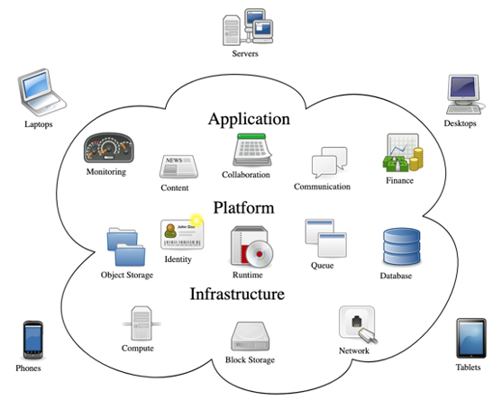
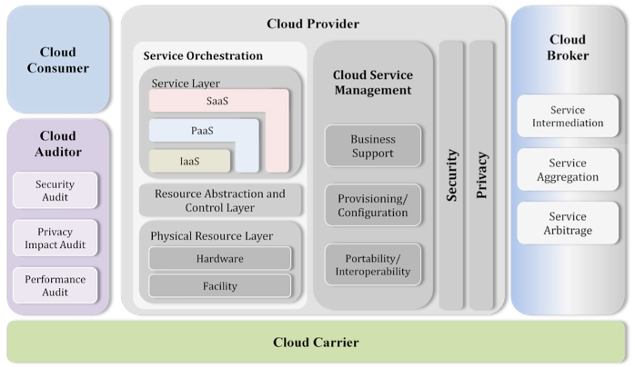
Cloud Computing
NIST Reference Architecture
There are a lot of concepts, aspects, types, … …
Some conceptual models for how it comes together.
Many applications and solutions build on all kinds of things from many clouds.
We will see examples of technology and use during the semester.

Slide 19
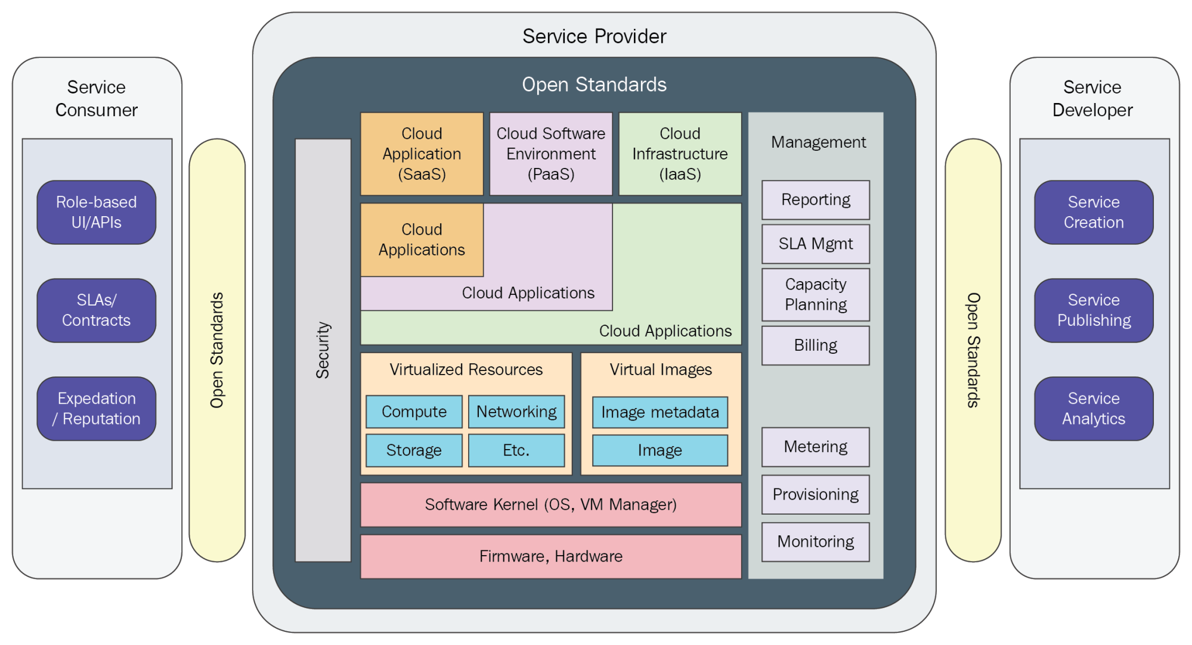

Slide 20
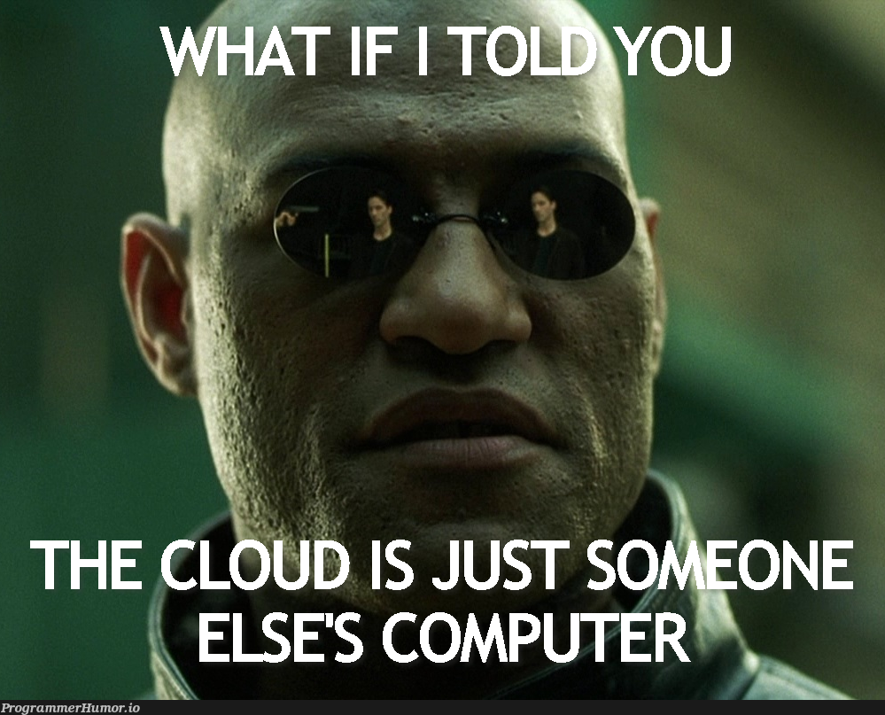
Definitions – The Best One

Slide 21
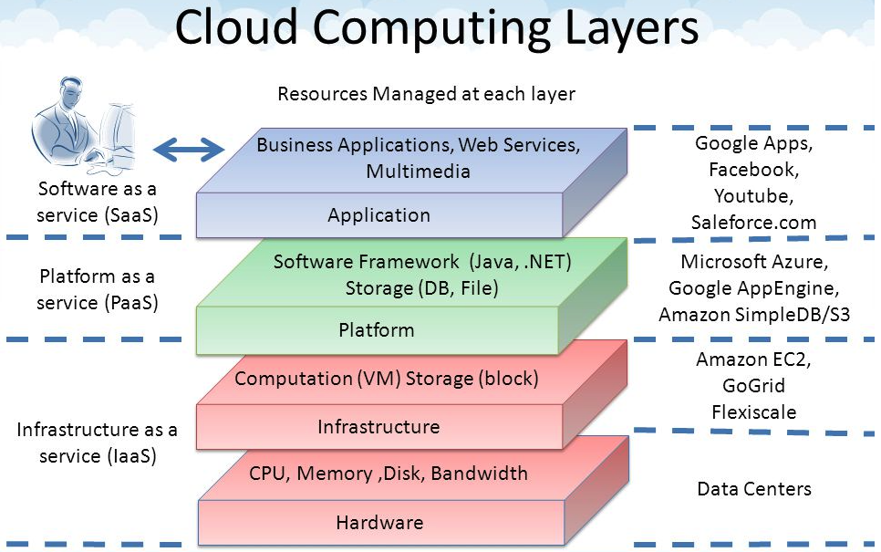
Core Layers
Our first cloud elements will
be IaaS (VMs).
Google Apps
Salesforce, Zendesk, ServiceNow, Concur, ... ...
Office 365, Trello
... ...
Google App Engine, AWS Elastic Beanstalk, ...
AWS SQS, Azure Queuing Service, Google PubSub
DynamoDB, Cosmos DB, ... ...
... ...
AWS EC2, Google Compute Engine, Azure VMs, ... ...
AWS Elastic Container Service, Azure Kubernetes, ... ...
IaaS is compute, storage, networking.
With an OS.
Delivered as a set of VMs and/or containers.

Slide 22
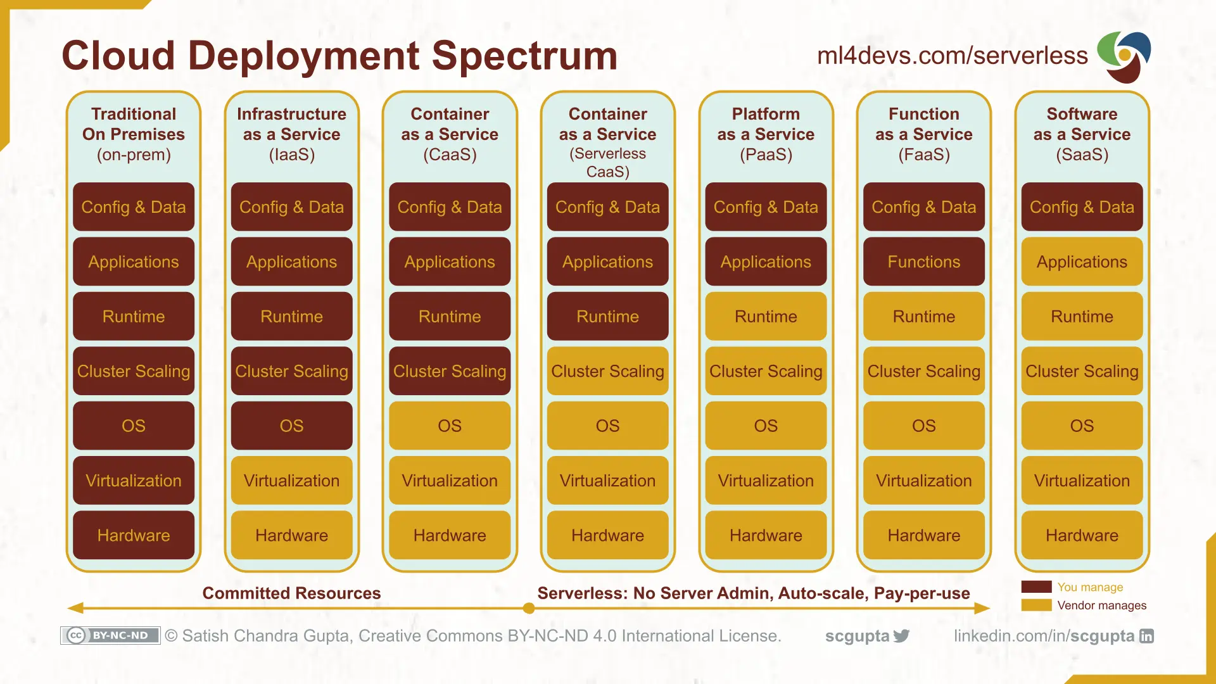
Cloud Layers

Slide 23
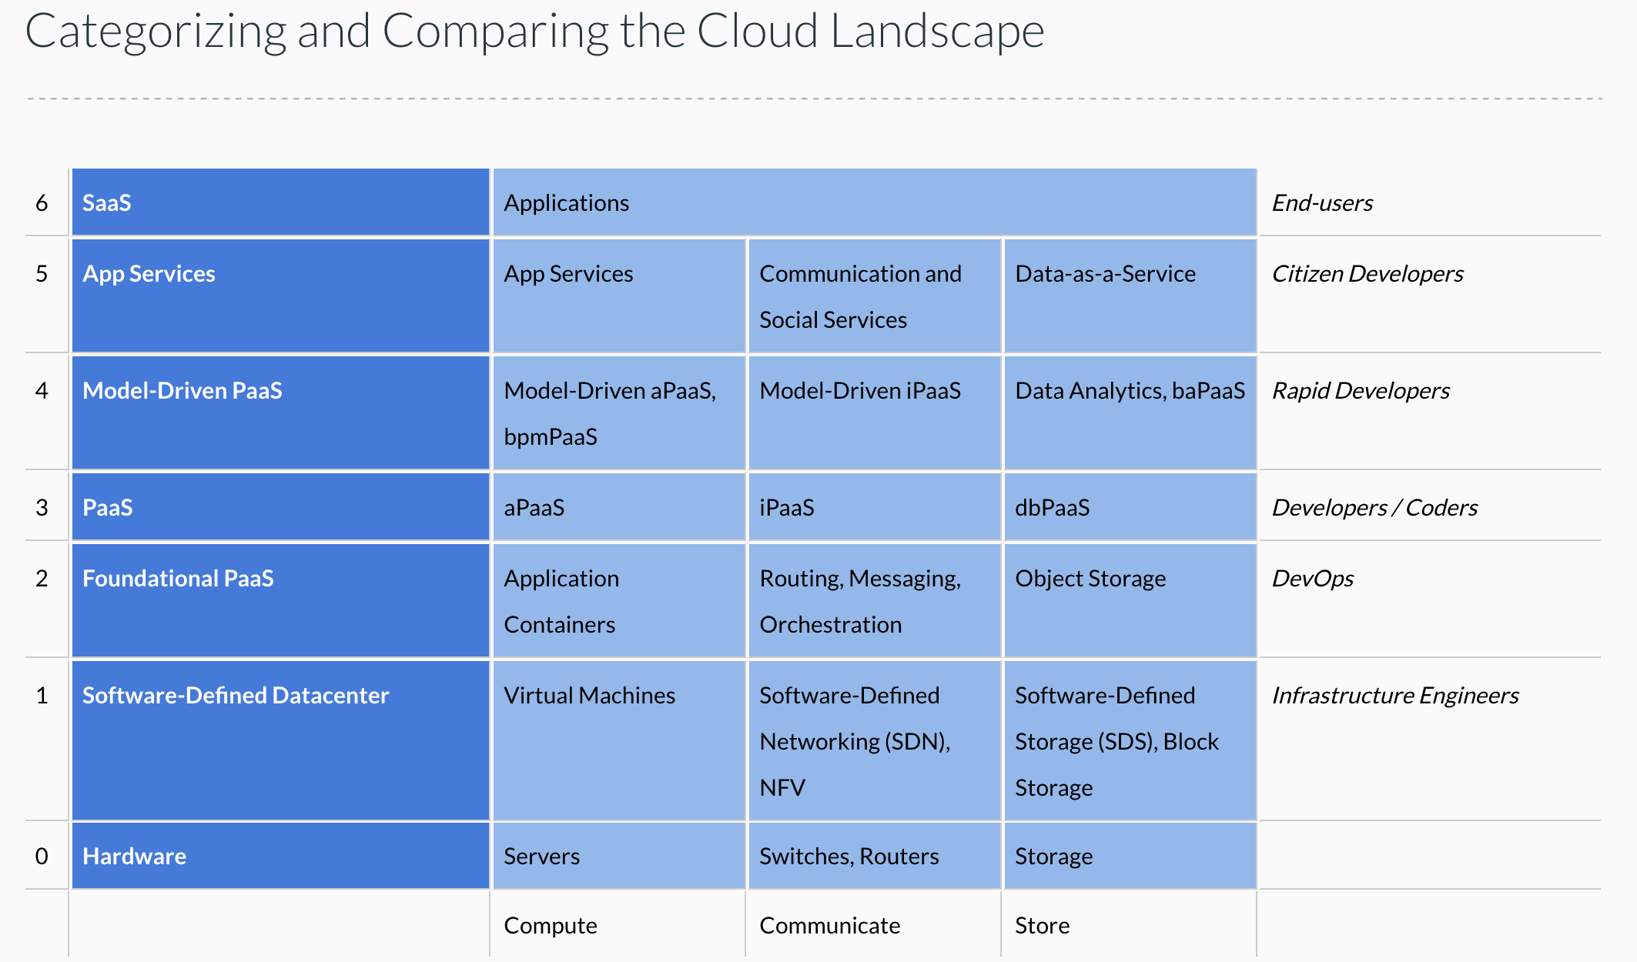
Cloud Concepts – One Perspective
http://www.theenterprisearchitect.eu/blog/2013/10/12/the-cloud-landscape-described-categorized-and-compared/

Slide 24
Why Cloud Computing?
Economy of scale:
There are fixed costs for a data center. One big data center of size N is more cost effective than N data centers.
The cloud service provider (CSP) can “buy in bulk” from HW suppliers.
The average matters:
A company must over provision resources to deal with surges in load/requests. Over provisioning by 3x is common before cloud.
The CSP can rely on averages. Not all N tenants will have surges at the same time. So, the CSP can over provision by a smaller amount than 3*N.
Elastic capacity:
Tenants do not need to over-provision.
They can “request” additional resources when there is a surge and then release. (scale up versus scale down)
Outsource non-core business functions:
A tenant does not want to manage buildings, pay water bills, … …
Buying HW, installing, configuring, monitoring and rebooting, … is a total downer.
The cloud takes over many systems and applications management and operations tasks.
Capital versus Operational Cost: Buying a house versus renting a hotel room.
On premises, non-cloud resources require capital investment, depreciation, ROI, … …
Cloud resources are rented and are operational.
There are many other reasons that you can just look up because I am too lazy to type.
Taking a cloud computing course looks really cool on your resume.

Slide 25
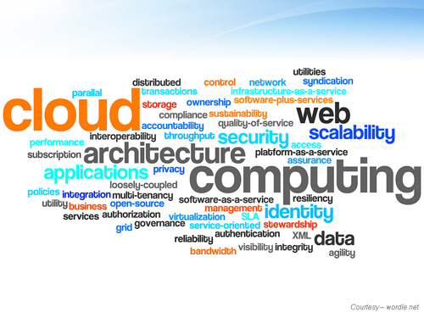
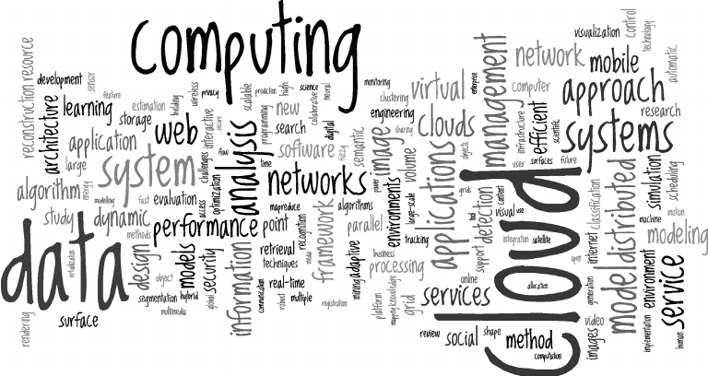
Cloud Computing Concepts
There are many, many cloud concepts, and many different perspectives on each concept.
Most cloud service providers offer their own specific versions of concepts and technology – But the core of the concept is similar.
We explore as many as we can by writing a “complex” application using the technology.
Each element in the application will be very simple, i.e. not deep application domain logic.
The overall application will have many and diverse implementations for elements.

Slide 26
Full Stack Web Application
Introduction
26 | W4153-24F-L1-Introduction-Concepts © Donald F. Ferguson, 2024

Slide 27
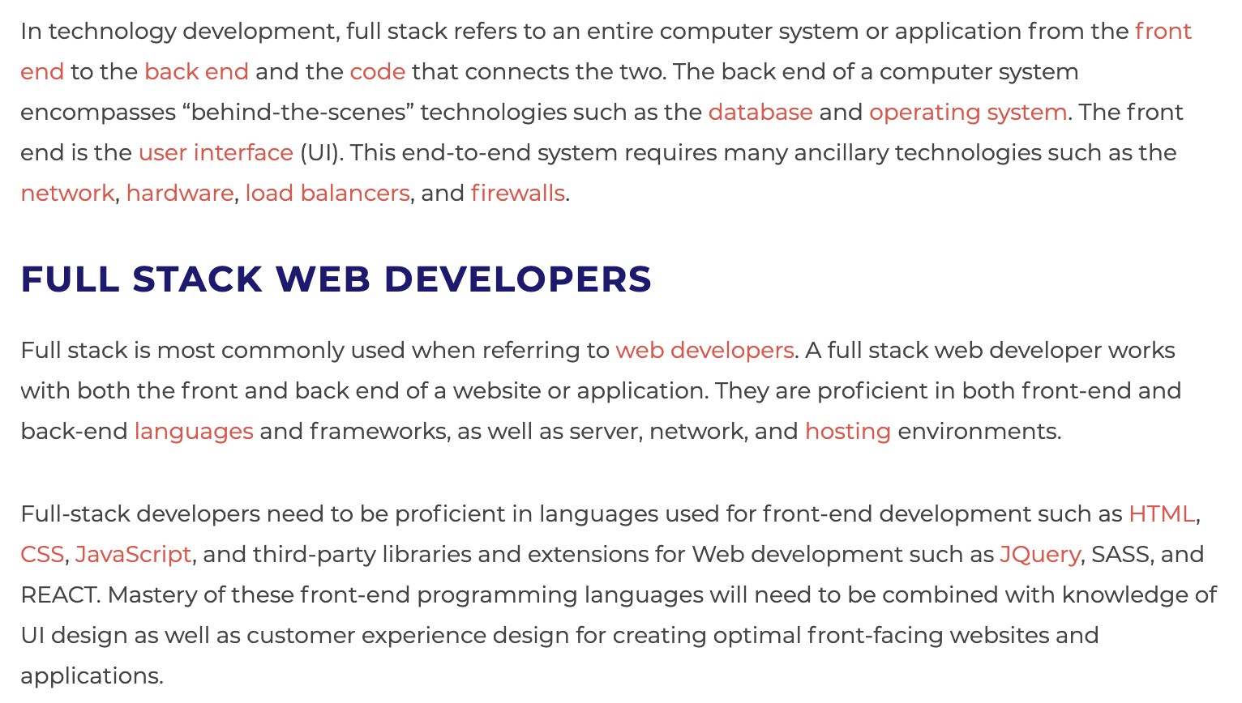
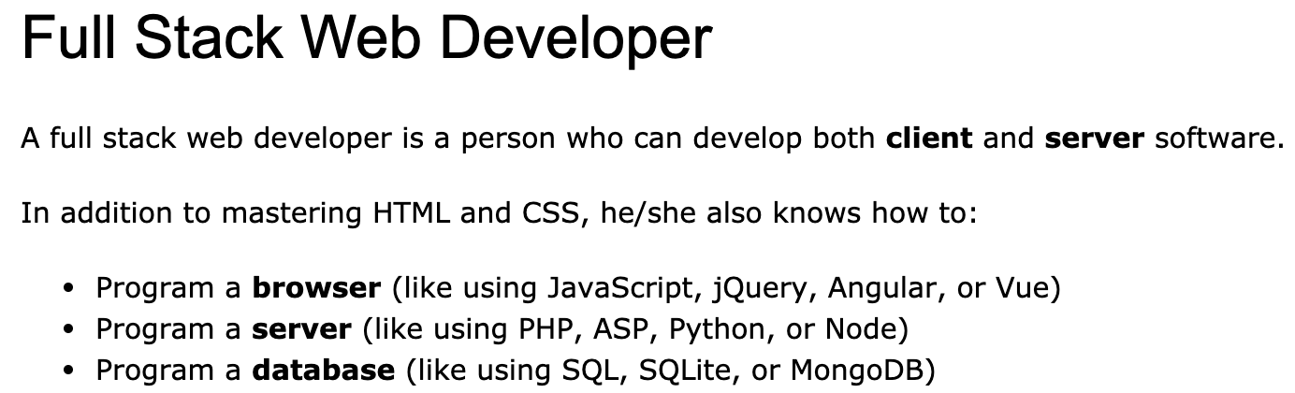
Full Stack Application
https://www.w3schools.com/whatis/whatis_fullstack.asp
There are courses that cover topics:
COMS W4153: Advanced Software Engineering
COMS W4111: Introduction to Databases
COMS W4170 - User Interface Design
This course will focus on cloud realization, microservices and application patterns, ... ...
Also, I am not great at UIs ... ... We will not emphasize or require a lot of UI work.
https://www.webopedia.com/definitions/full-stack/

Slide 28
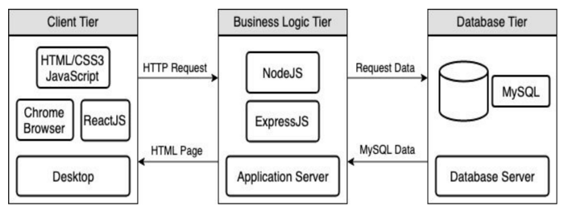
Full Stack Web Application
M = Mongo
E = Express
R = React
N = Node
I start with FastAPI and MySQL, but all the concepts are the same.
https://levelup.gitconnected.com/a-complete-guide-build-a-scalable-3-tier-architecture-with-mern-stack-es6-ca129d7df805
My preferences are to replace React with Angular, and Node with Flask.
There are three projects to design, develop, test, deploy, ... ...
Browser UI application.
Microservice.
Database.
We will initial have two deployments: local machine, virtual machine. We will ignore the database for step 1.

Slide 29
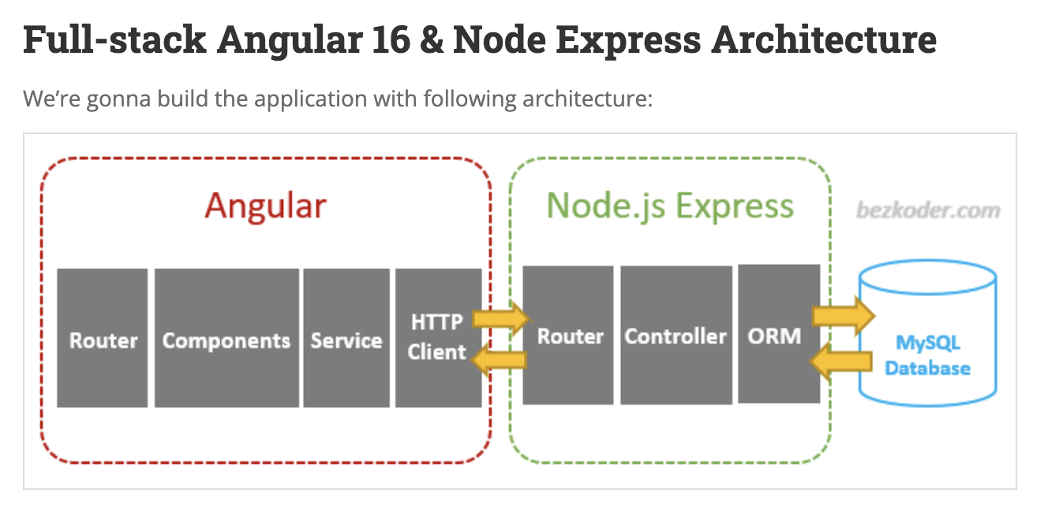
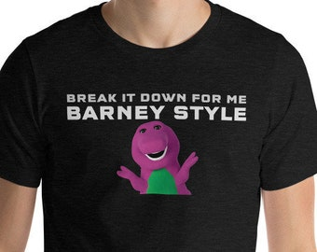
Walkthrough of a Set of Examples
I found a got set of starter examples at BezCoder.com:
Full Stack: https://www.bezkoder.com/category/full-stack/.
I will quickly walk through an example
This shows core concepts and has a lot of step-by-step guides.
I tend to use Python/FastAPI in my examples and lectures but do not provide a tutorial that ”breaks it down Barney Style.”
~/Dropbox/000/00-Current-Repos/W4153/angular-17-crud-example
~/Dropbox/000/00-Current-Repos/W4153/nodejs-express-mysql

Slide 30
Very First Step (Individual)
Create 3 GitHub projects (use any names you want) – Mine are:
W4153-P1-UI (https://github.com/donald-f-ferguson/W4153-P1-UI.git)
W4153-P1-Application (https://github.com/donald-f-ferguson/W4153-P1-Application.git)
W4153-P1-Database (https://github.com/donald-f-ferguson/W4153-P1-Database.git)
We will
Develop each project locally.
Unit test locally.
Integration test locally.
Manually deploy to the cloud platform.
Test again.

Slide 31
An Aside on Modeling
Introduction
31 | W4153-24F-L1-Introduction-Concepts © Donald F. Ferguson, 2024

Slide 32
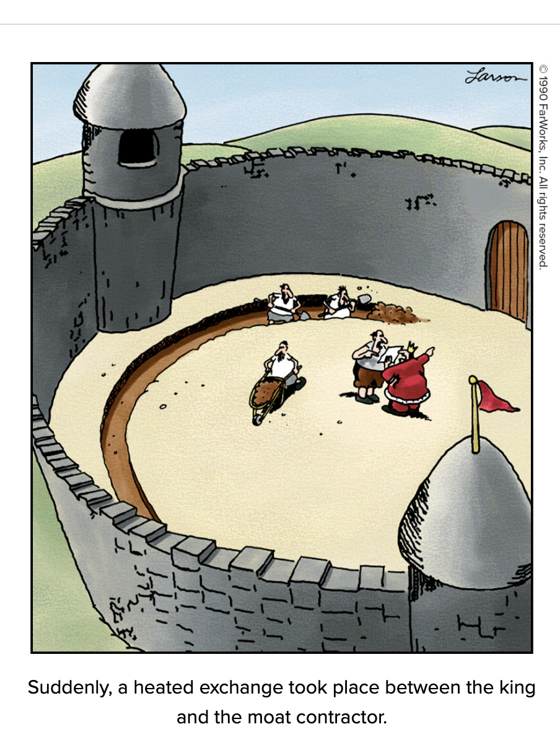
The Value of Just Enough Modeling
Weinberg's Second Law: “If builders built buildings the way programmers wrote programs, then the first woodpecker that came along would destroy civilization.”
Give your project, code, … a little upfront thought. Focus on simple steps, test and then next step.
Most students and teams build their systems and write their code like a slam poet on a triple espresso.
Just enough modeling and thought, with simple steps and frequent testing seems slow, but … … “Slow is smooth. Smooth is fast.”

Slide 33
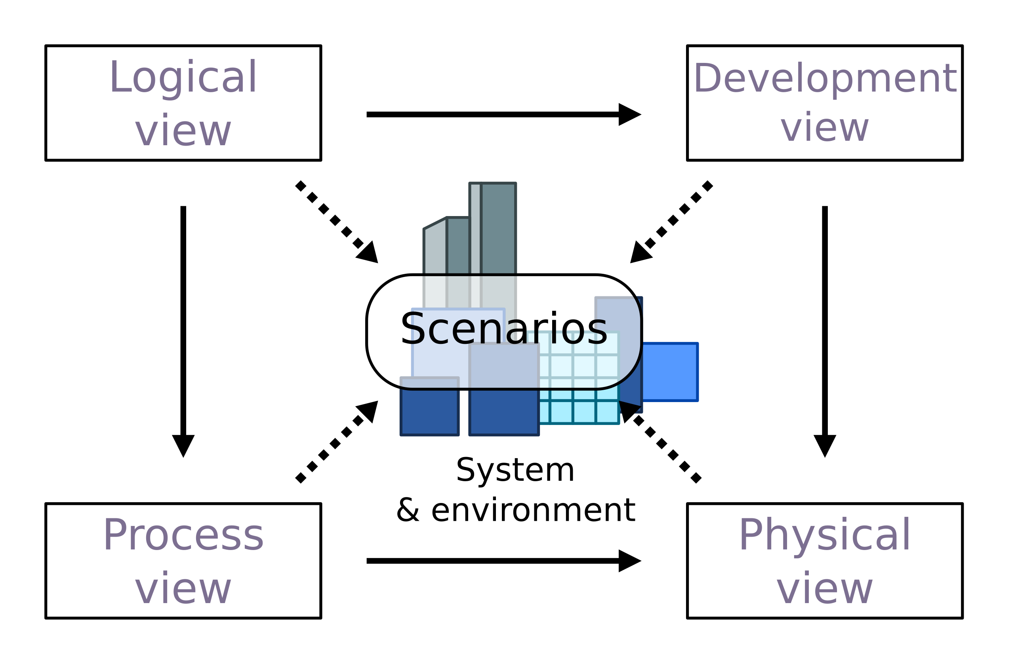
4+1 Architecture Model
I try to apply “just enough” modeling in 5 areas.
The 4+1 Architecture Model is a simple, conceptual approach.
I have a preferred ”notation” for each “view.”

Slide 34
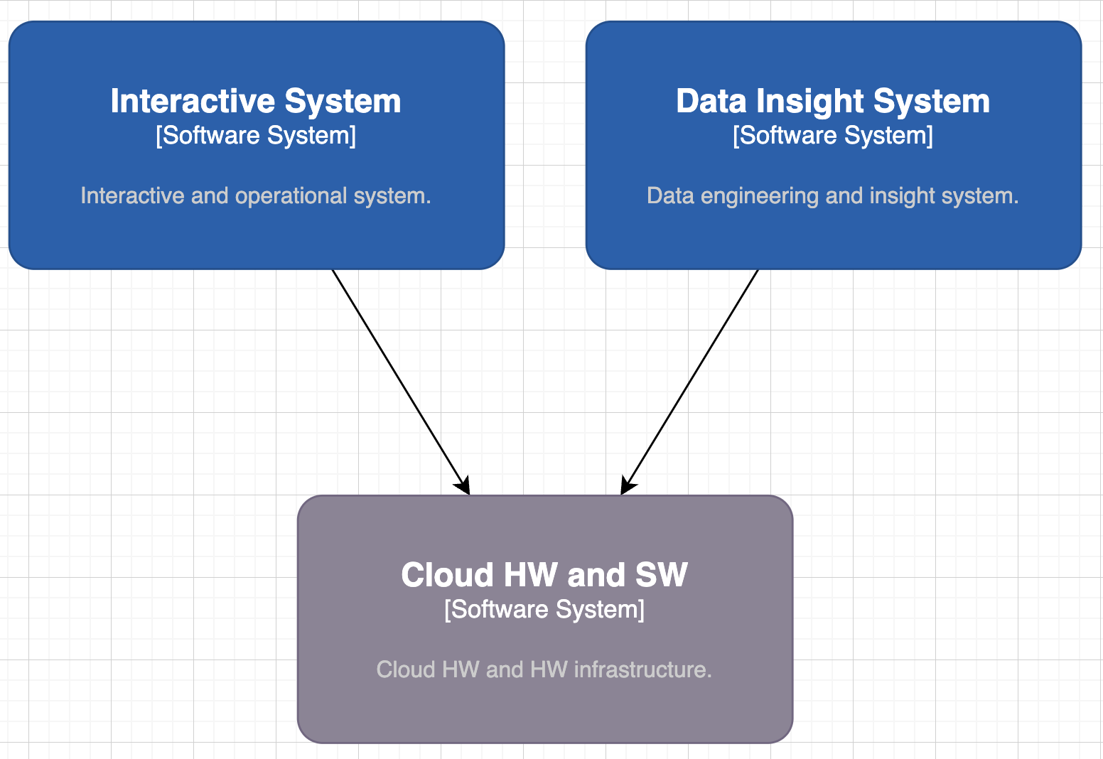
Class Project Solution – Logical View
I use C4 and UML for the logical model.
Many complex solutions have two major elements:
Operational/Interactive
Analytical/Data Analysis
We place more emphasis on interactive because there are topics courses on cloud and data.

Slide 35
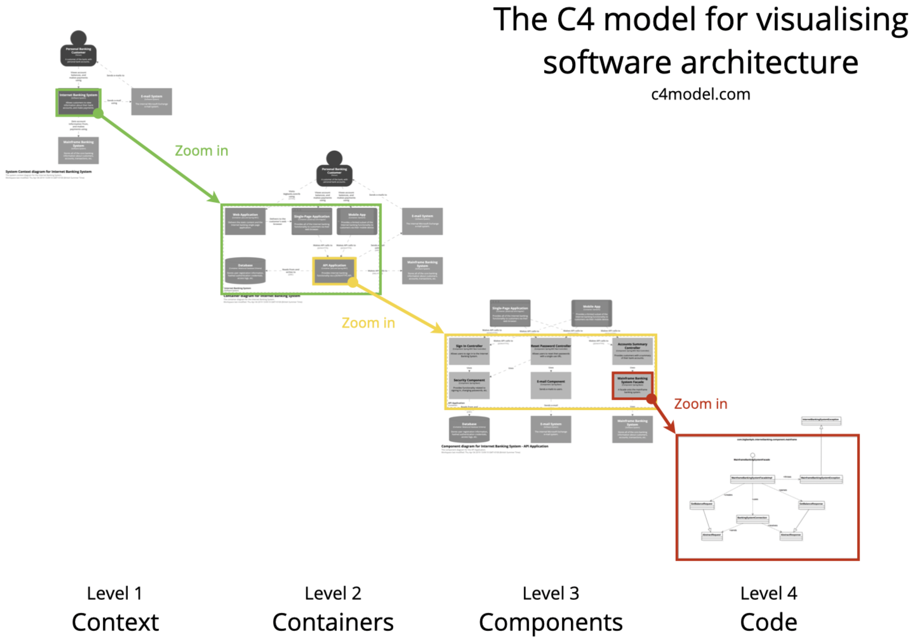
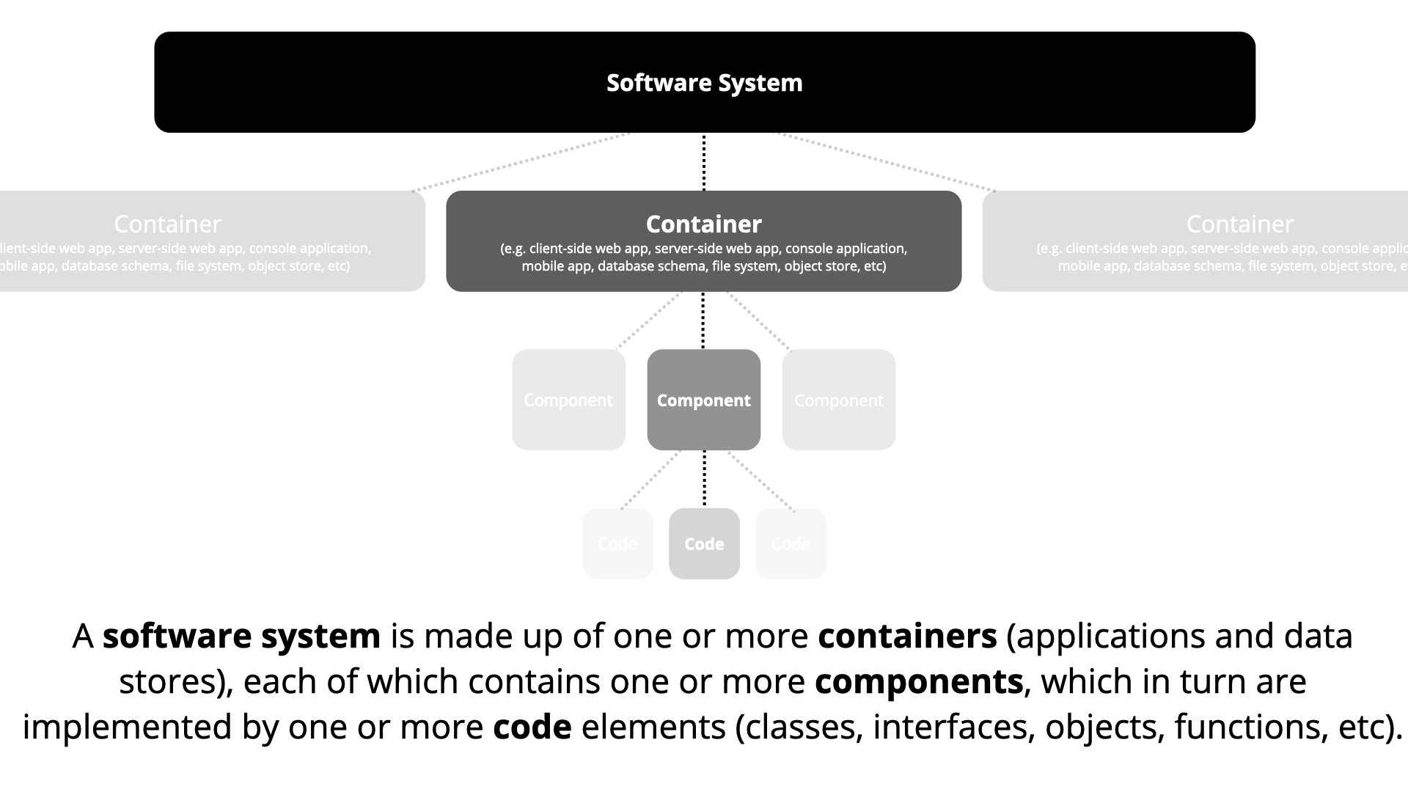
C4 Model (https://c4model.com/)
Incremental, progressive design and refinement.
Again, “just enough” to think it through and explain.

Slide 36
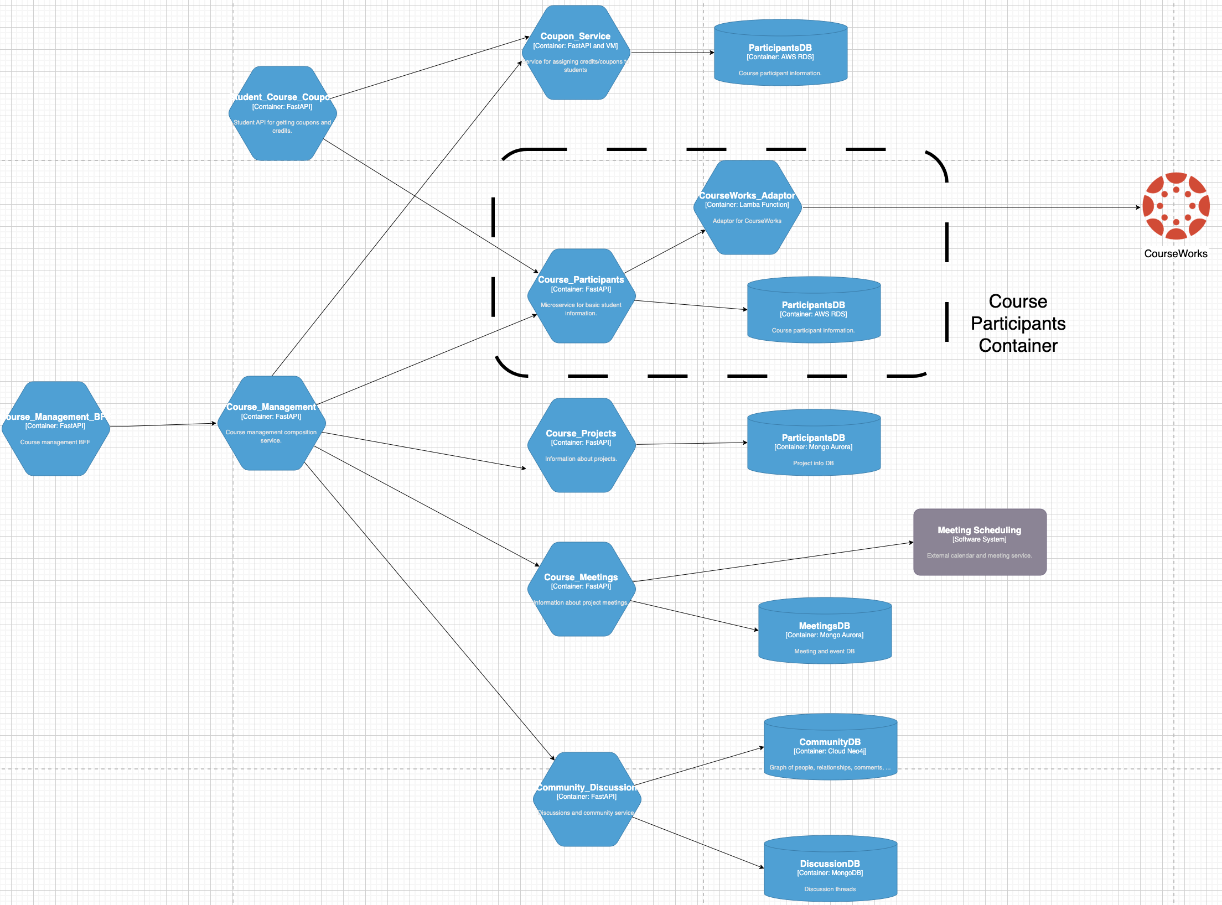
(Partial) Logical View – Interactive System
Some of the distinctions are arbitrary or in the ”eye of the beholder.”
System vs Container
Container vs Component
etc.
A container is not synonymous with a “Docker container.”
I have been in SW for 40 years and we still cannot define terms like “component.”
Just use common sense.
In general, containers in the cloud are microservices.”

Slide 37
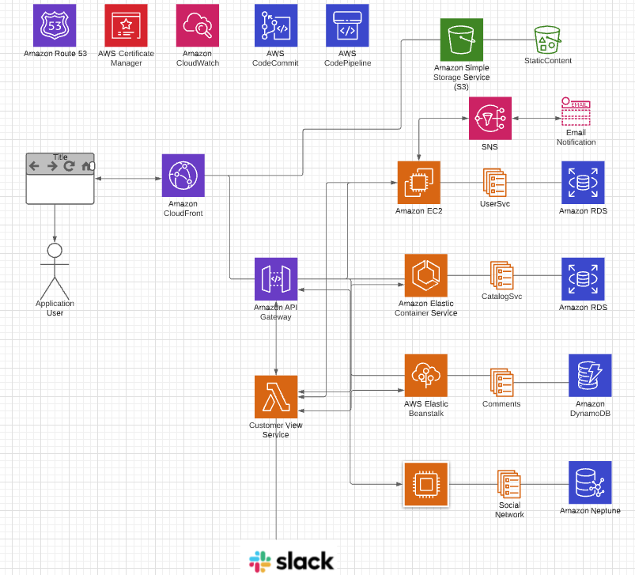
Physical View
Note: Cannot show all of the technology and connections with creating spaghetti.
Databases/Storage:
RDS
DynamoDB
MongoDB (or Document DB)
Neptune (or Neo4j)
S3
Networking/Communication:
Route 53 (DNS)
Certificate Management
CloudFront
VPC
API Gateway
Compute:
EC2
Elastic Beanstalk
Elastic Container Service (or Docker)
Lambda Functions
Integration/collaboration:
SNS, SQS
Email
Slack
Continuous Integration/Continuous Deployment:
Code Commit, Code Pipeline
Or GitHub and actions
This is directional.
I will modify and evolve.
This is AWS focused, but we will use GCP.

Slide 38
Microservices
Introduction
38 | W4153-24F-L1-Introduction-Concepts © Donald F. Ferguson, 2024

Slide 39
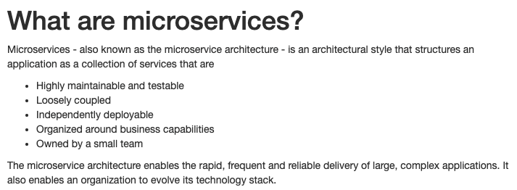
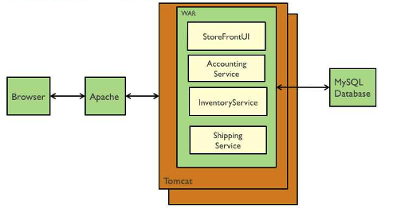
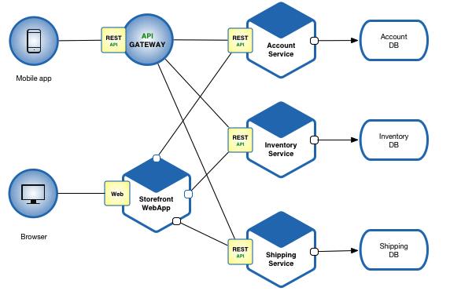
Microservices (https://microservices.io/index.html)
Microservice benefits relative to monoliths are hard to understand without having developed and maintained monoliths.
Cars are “cool.” Cars are totally, super cool if you had to go into town using a horse drawn carriage.
Microservices Architecture
Monolithic Architecture

Slide 40
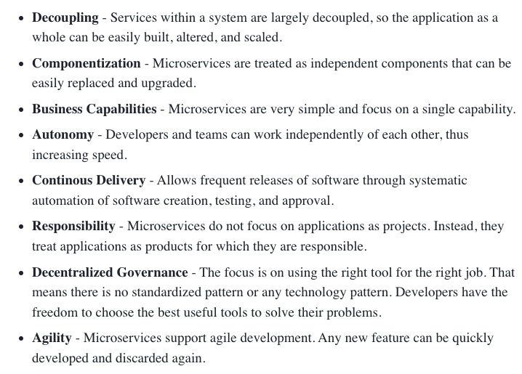
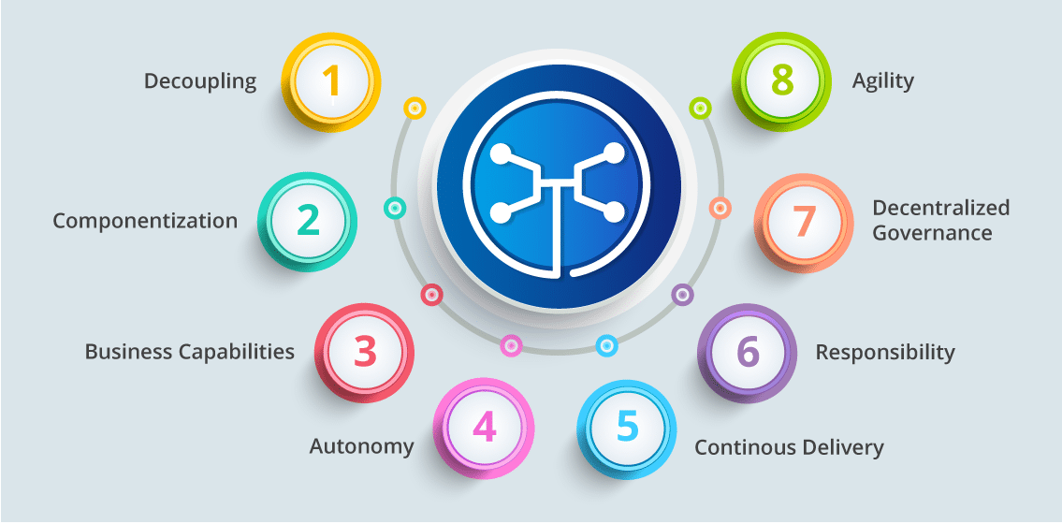
Microservice Characteristics (https://dzone.com/articles/what-is-microservices-an-introduction-to-microserv)
Microservice Characteristics

Slide 41
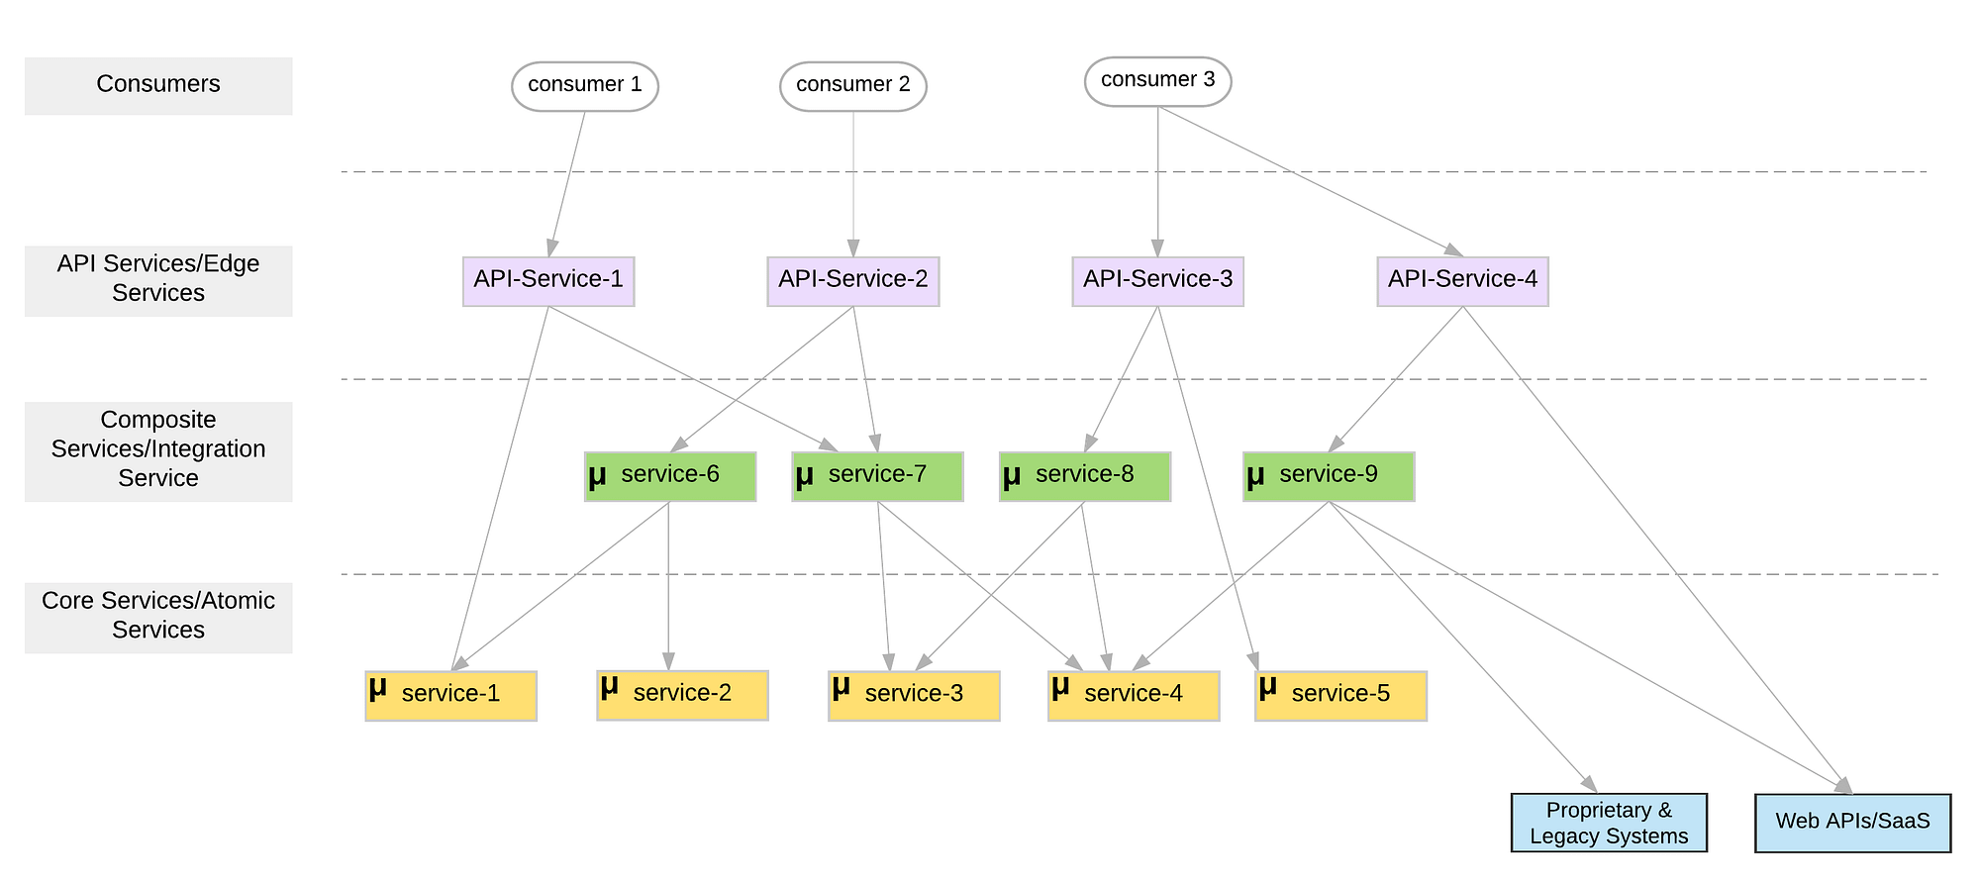
Microservice Layers (https://medium.com/microservices-in-practice/microservices-layered-architecture-88a7fc38d3f1)

Slide 42
Microservice Details and Perspectives
Some sites for good, introductory overviews and more information about microservices:
https://martinfowler.com/articles/microservices.html
https://microservices.io/
https://aws.amazon.com/microservices/
What is true of any:
Mapping, classification, taxonomy, ... ...?
Technology definition, ... ...?
Enumeration of technology pros and cons ... ...?
Answers:
“... ... it is ... ... More honor'd in the breach than the observance”
If you have three subject matter experts, you have 7 conflicting opinions.
”The most dangerous thing in the world is a 2nd LT with a map.” Like any map, it is both a way of orientating yourself and a way of having a spectacular disaster because you are studying the map instead of thinking.

Slide 43
Design Patterns
Introduction
43 | W4153-24F-L1-Introduction-Concepts © Donald F. Ferguson, 2024

Slide 44
Design Patterns
“In software engineering, a software design pattern is a general, reusable solution to a commonly occurring problem within a given context in software design. It is not a finished design that can be transformed directly into source or machine code. Rather, it is a description or template for how to solve a problem that can be used in many different situations. Design patterns are formalized best practices that the programmer can use to solve common problems when designing an application or system.” (https://en.wikipedia.org/wiki/Software_design_pattern)
We will cover design patterns in several aspects:
SW patterns for building code “in microservices.” How do you write the code?
Architecture patterns for microservices and composition into complex solutions.
Cloud architecture patterns: how do you solve problems with cloud technology.
Data modeling and data access patters.
… …

Slide 45
Microservice Pattern Language (One Perspective)
If you are trying to solve a problem or implement something,
You are probably not the first person to do so.
Probably a lot of other people have tried, failed and then learned.
Ask Google or ChatGPT what others do.
A knowledge of basic design patterns is useful to guide architecture/implementation decisions.
We will cover when encountering tasks and challenges.
https://microservices.io/patterns/index.html

Slide 46
There are a Lot of Design Patterns
https://blog.beehyv.com/design-patterns-in-microservices-enhancing-scalability-flexibility-and-maintainability-197e499a575b
https://medium.com/@madhukaudantha/microservice-architecture-and-design-patterns-for-microservices-e0e5013fd58a

Slide 47
Our First Design Patterns: Adapter, Anti-Corruption
Adapter
Adapter

Slide 48
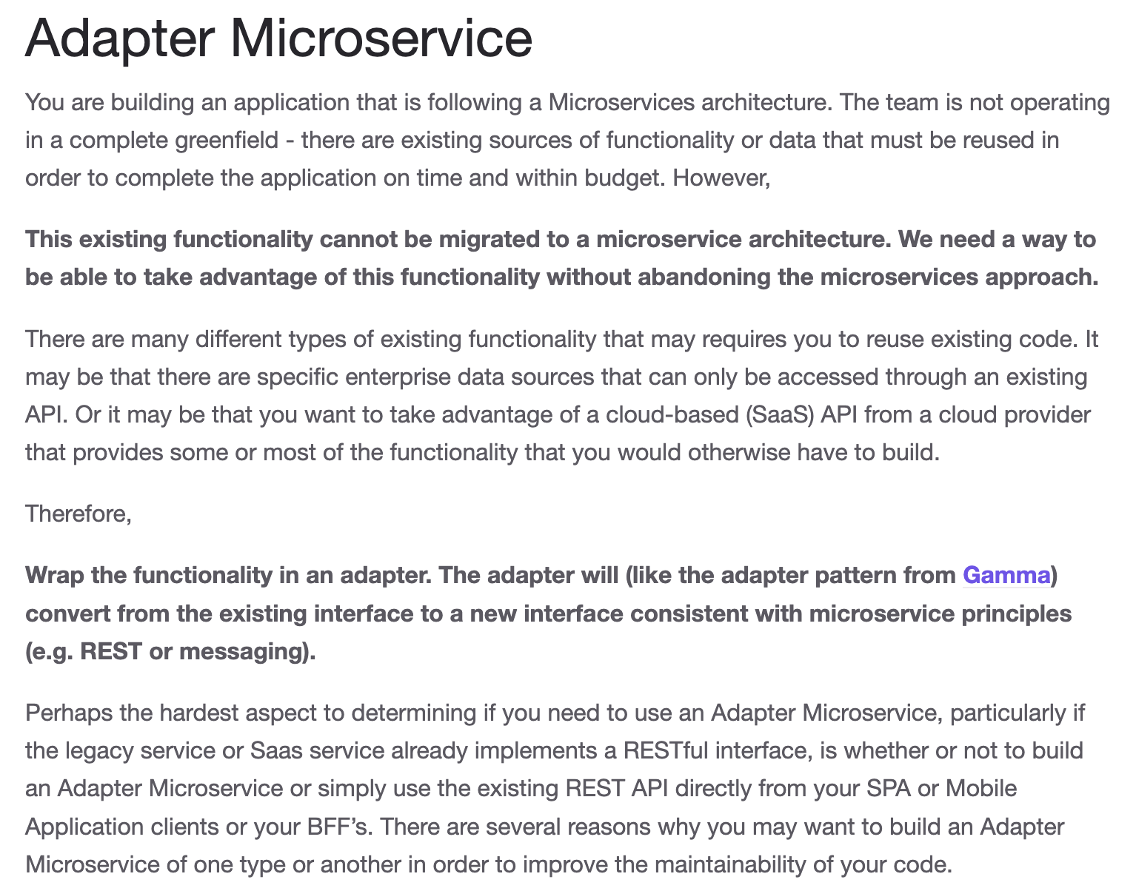
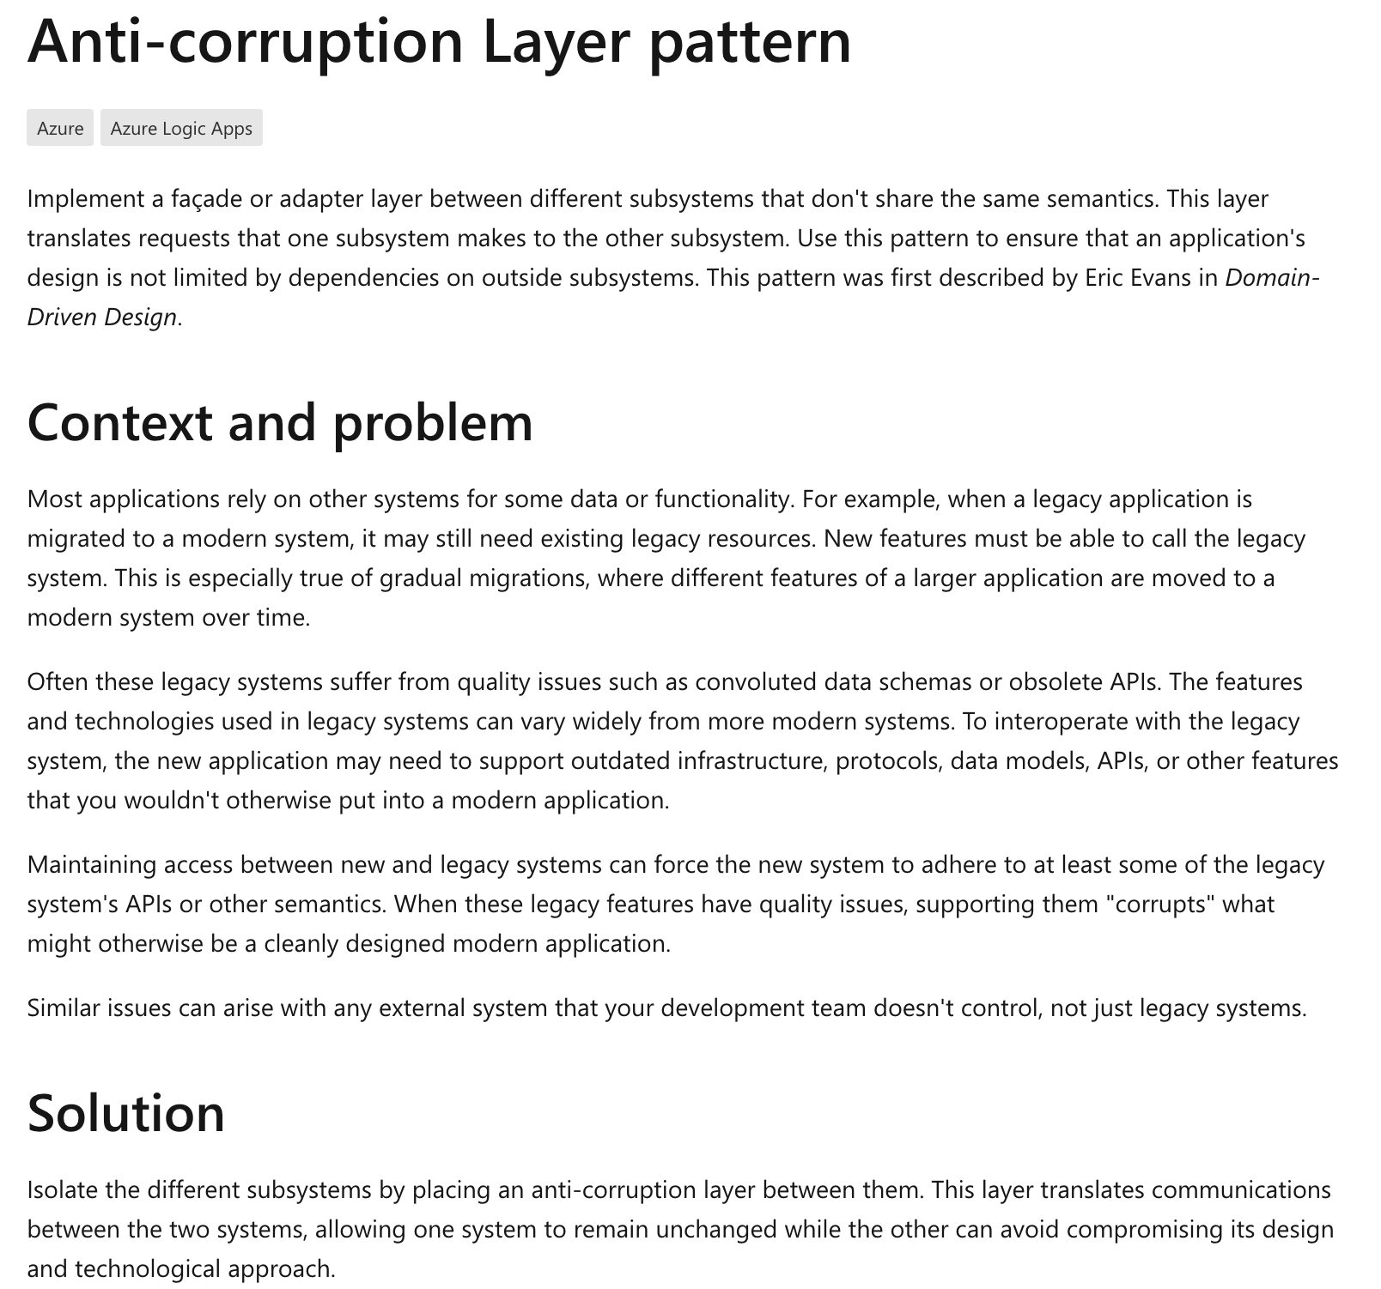
Adapter and Anti-Corruption
https://kgb1001001.github.io/cloudadoptionpatterns/
https://learn.microsoft.com/en-us/azure/architecture/patterns/anti-corruption-layer

Slide 49
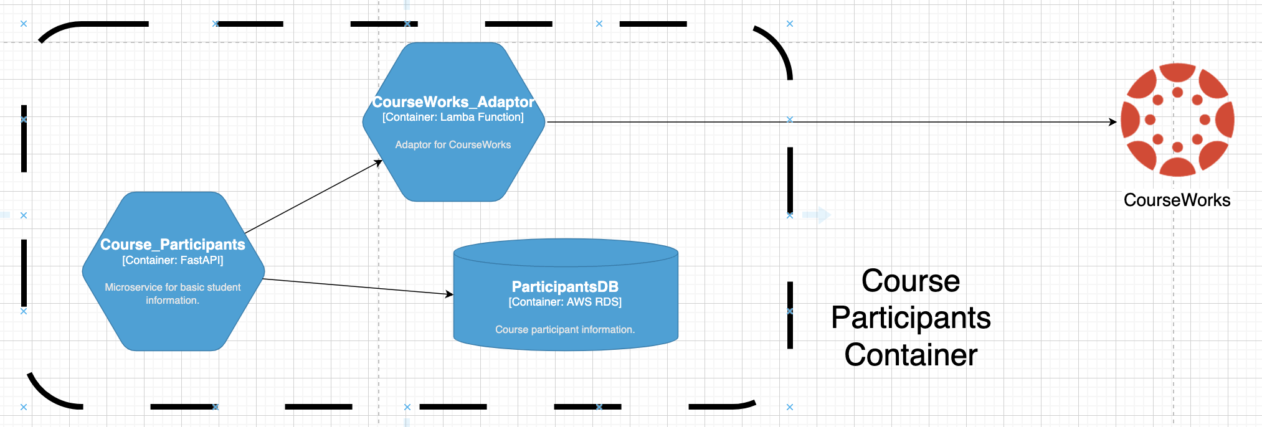
CourseWorks Adaptor
CourseWorks has an API. It is an HTTP based API. And is sort of “REST” like, but is kind of wonky. (https://canvas.instructure.com/doc/api/all_resources.html).
I want to define a preferred, canonical model for courses, sections, participants for my solution.
And map the model to CourseWorks, and have the option for changing.

Slide 50
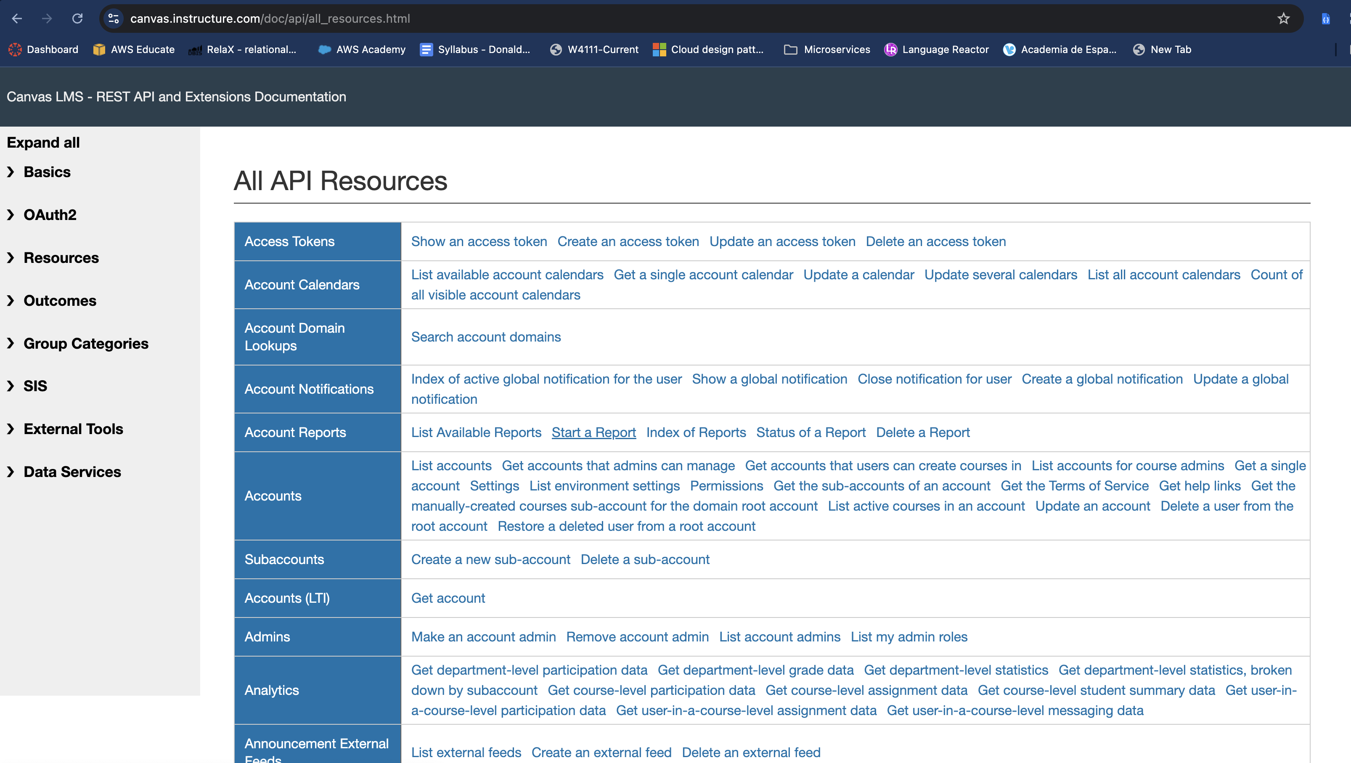
CourseWorks/Canvas LMS API

Slide 51
CourseWorks Adaptor
Show API calls and code in the Jupyter Lab/Notebook.

Slide 52
Application Development Concepts
Introduction
52 | W4153-24F-L1-Introduction-Concepts © Donald F. Ferguson, 2024

Slide 53
First (Individual) Project
Introduction
53 | W4153-24F-L1-Introduction-Concepts © Donald F. Ferguson, 2024

Slide 54
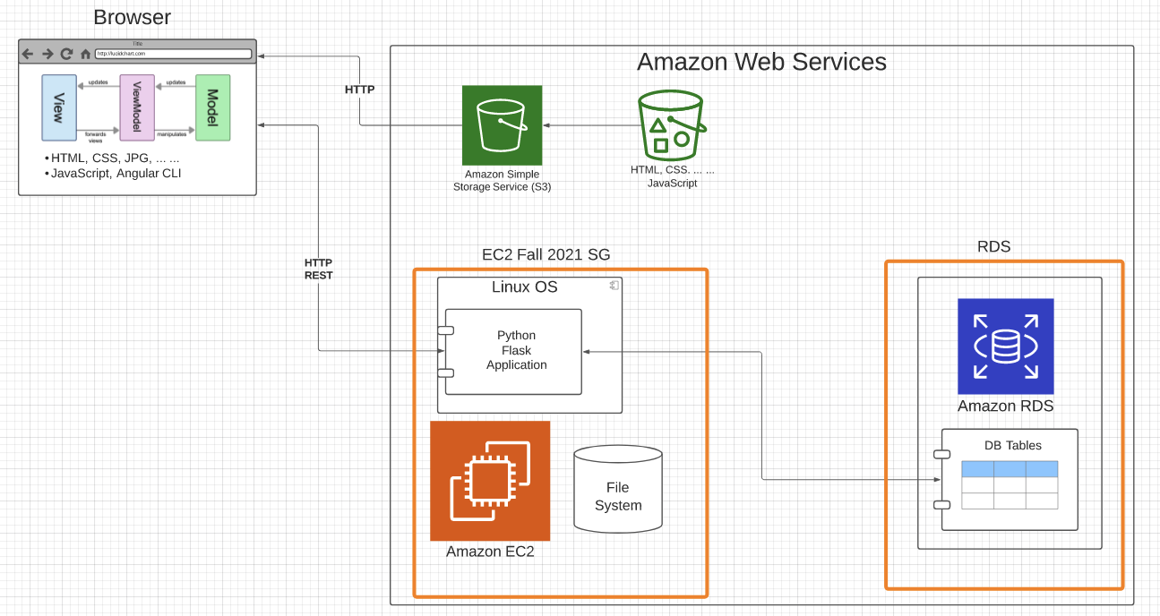
Sample Application Structure (Step 2, 3)
Browser Application:
Content: HTML, CSS, ... ...
MVVM with Angular CLI
Static Content:
S3 Bucket
Web site hosting
Server: Amazon EC2 instance (IaaS)
Linux
Web Application Server
Flask
Python
Database: Amazon RDS (DBaaS)
Simple tables
MySQL Database Server
Lifecycle:
Develop and demo locally
Deploy and configure onto AWS
Will work on CI/CD later.
Two security groups:
One for EC2 instance
One for RDS
Slightly more secure than 1 SG.
Will cover security later.

